Slide 1
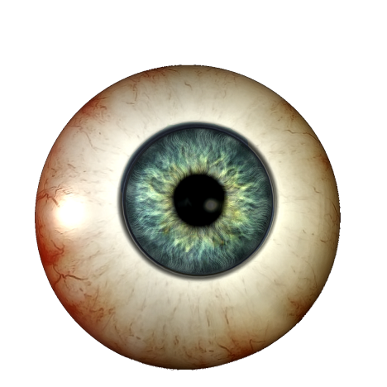
Gaze Estimation
CMPE537 - 2010

Slide 2
Motivation
User - computer interaction

Slide 3
Motivation
User - computer interaction
Assistance to disabled

Slide 4
Motivation
User - computer interaction
Assistance to disabled
Behavior characterization

Slide 5
Motivation
User - computer interaction
Assistance to disabled
Behavior characterization
Interface usability
Marketing research
Drivers

Slide 6
Motivation
User - computer interaction
Assistance to disabled
Behavior characterization
Interface usability
Marketing research
Drivers
Many more
Cognitive Studies ● Medical Research ● Human Factors ● Computer Usability ● Translation Process Research ● Vehicle Simulators ● In-vehicle Research ● Training Simulators ● Virtual Reality ● Adult Research ● Infant Research ● Adolescent Research ● Geriatric Research ● Primate Research ● Sports Training ● fMRI / MEG / EEG ● Communication systems for disabled ● Improved image and video communications ● Computer Science: Activity Recognition

Slide 7
Methods

Slide 8
Method I
Diego Torricelli , Silvia Conforto , Maurizio Schmid , Tommaso D'Alessio, A neural-based remote eye gaze tracker under natural head motion, Computer Methods and Programs in Biomedicine, v.92 n.1, p.66-78, October, 2008

Slide 9
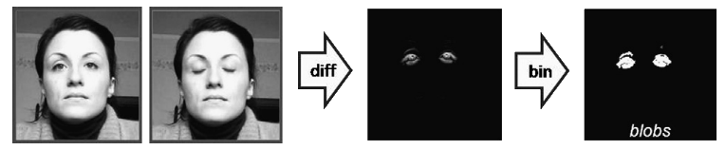
Torricelli et al.
Blink Detection

Slide 10
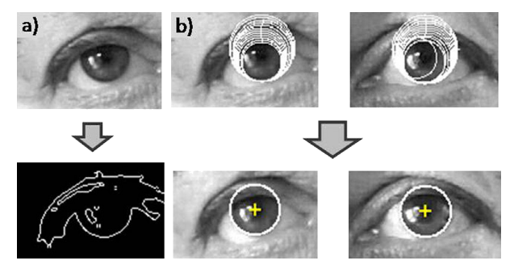
Torricelli et al. (cont’d)
Sobel + Hough transform

Slide 11
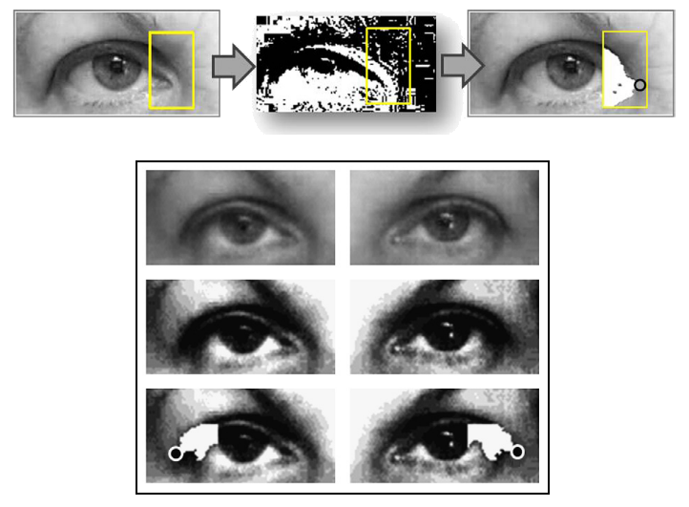
Torricelli et al. (cont’d)
Corner detection using thresholding

Slide 12
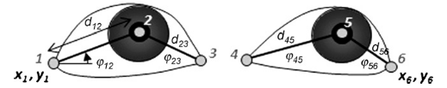
Torricelli et al. (cont’d)
12 parameters

Slide 13
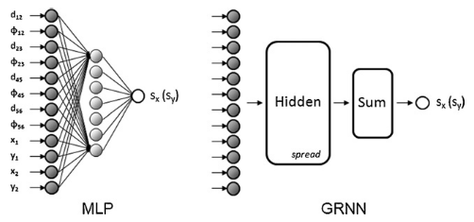
Torricelli et al. (cont’d)
Parameters fed to neural network
Multilayer perceptron
General regression network

Slide 14
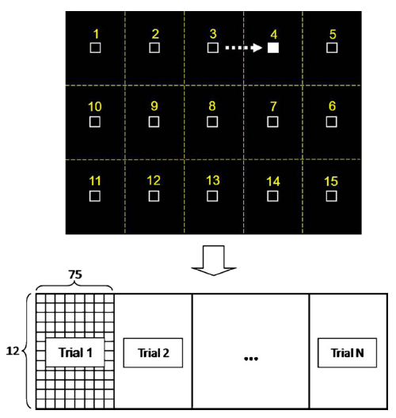
Torricelli et al. (cont’d)
Dataset

Slide 15
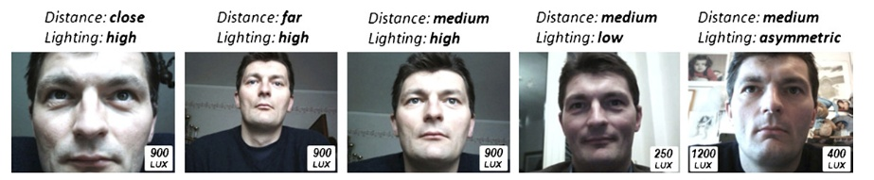
Torricelli et al. (cont’d)
Dataset
All frontal views, no tilt/turn

Slide 16
Torricelli et al. (cont’d)
Results
Zone recognition 94.7%
Gaze error
Horizontal 1.4°±1.7°
Vertical 2.9°±2.2°

Slide 17
Method II
Hirotake Yamazoe , Akira Utsumi , Tomoko Yonezawa , Shinji Abe, Remote gaze estimation with a single camera based on facial-feature tracking without special calibration actions, Proceedings of the 2008 symposium on Eye tracking research & applications, March 26-28, 2008, Savannah, Georgia

Slide 18
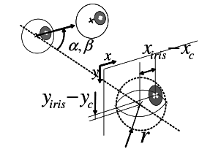
Yamazoe et al.
Gaze can be estimated using:

Slide 19
Yamazoe et al.
Gaze can be estimated using:

Slide 20
Yamazoe et al. (cont’d)
Facial features are detected and tracked

Slide 21
Yamazoe et al. (cont’d)
Facial features are detected and tracked
N images captured for calibration

Slide 22
Yamazoe et al. (cont’d)
Facial features are detected and tracked
N images captured for calibration
3D reconstruction

Slide 23
Yamazoe et al. (cont’d)
Facial features are detected and tracked
N images captured for calibration
3D reconstruction
Eye model estimation by nonlinear optimization

Slide 24
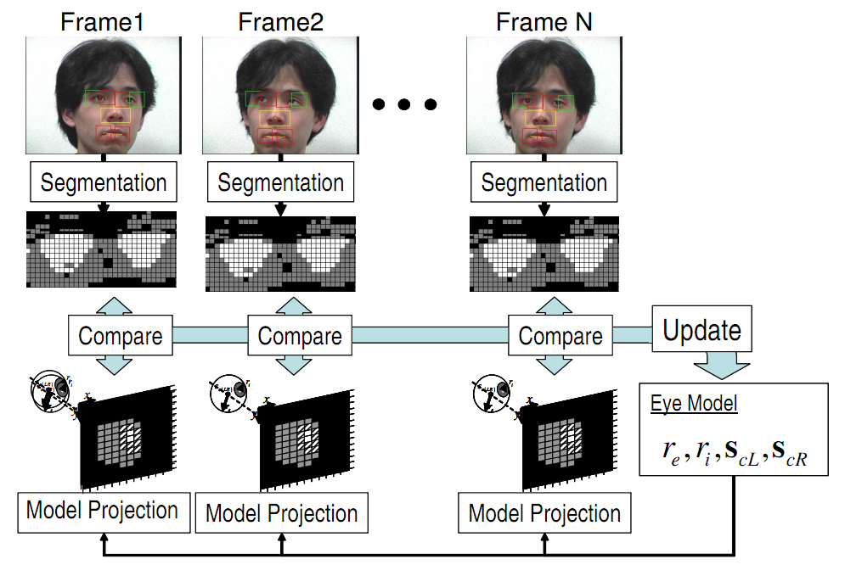
Yamazoe et al. (cont’d)

Slide 25
Yamazoe et al. (cont’d)
Given an input image
Facial features are extracted
Locate iris centers
Other eye parameters can be calculated using at least 4 facial features

Slide 26
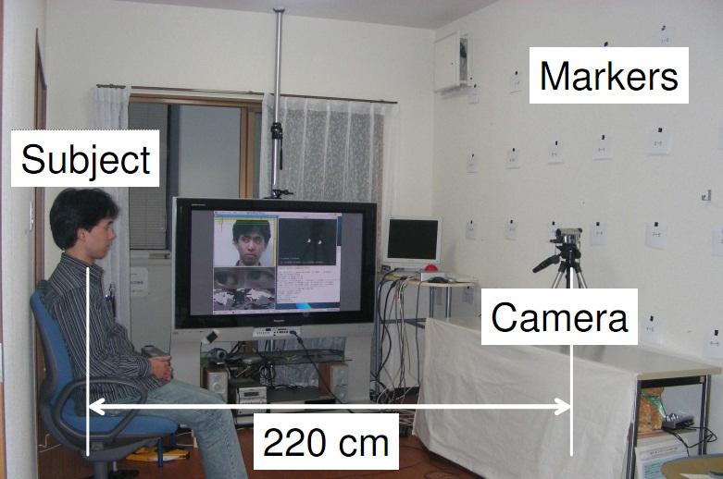
Yamazoe et al. (cont’d)
Dataset

Slide 27
Yamazoe et al. (cont’d)
Results
Horizontal err 5.3°
Vertical err 7.7°

Slide 28
Yamazoe et al. (cont’d)
Results
Horizontal err 5.3°
Vertical err 7.7°
Error gets high for lower markers
Eyelids

Slide 29
Method III
Haiyuan Wu , Yosuke Kitagawa , Toshikazu Wada , Takekazu Kato , Qian Chen, Tracking Iris contour with a 3D eye-model for gaze estimation, Proceedings of the 8th Asian conference on Computer vision, November 18-22, 2007, Tokyo, Japan

Slide 30
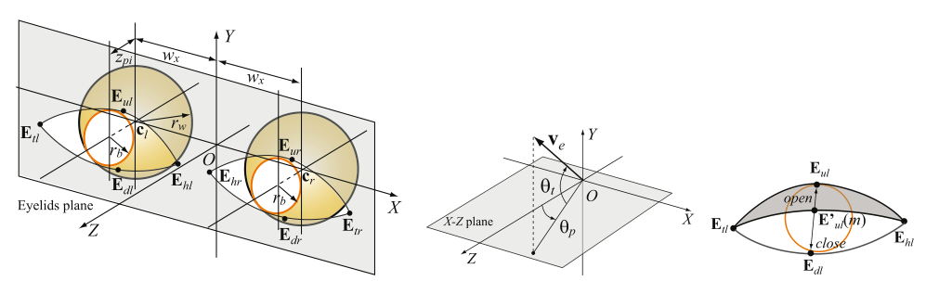
Wu et al.
3D Eye model with eyelid

Slide 31
Wu et al. (cont’d)
Iris contours tracked using with particle filter

Slide 32
Wu et al. (cont’d)
Iris contours tracked using with particle filter
Likelihood function
Iris is less brighter than its surrounding

Slide 33
Wu et al. (cont’d)
Eyelid contours tracked using with particle filter

Slide 34
Wu et al. (cont’d)
Eyelid contours tracked using with particle filter
Likelihood function
No particular property
Image gradient

Slide 35
Wu et al.
Eye corners are marked manually
Eyeball parameters are assumed to be equal for everyone

Slide 36
Wu et al. (cont’d)
Eye corners are marked manually
Eyeball parameters are assumed to be equal for everyone

Slide 37
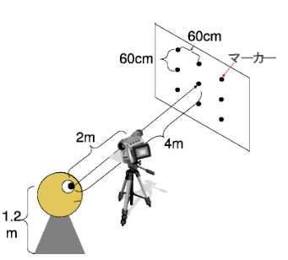
Wu et al. (cont’d)
Dataset

Slide 38
Wu et al. (cont’d)
Results
Horizontal Err 2.5°
Vertical Err 3.5°

Slide 39
Proposed Method

Slide 40
Proposed Method
Combine Method II and III
Use the same approach in Method II, take eyelids into account

Slide 41
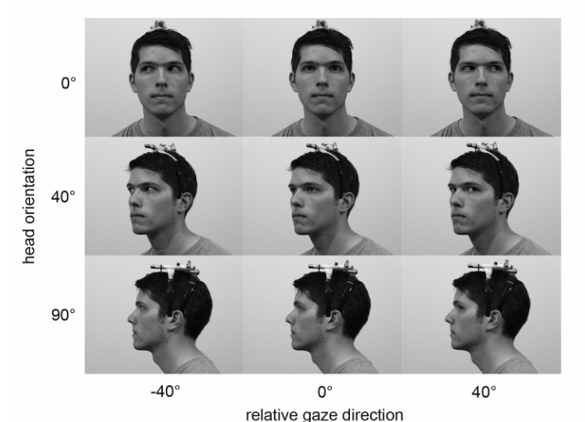
Proposed Method
Dataset
uulmHPGDatabase

Slide 42
MANY THANKS
Gaze Estimation CMPE537 - 2010

